Slide 1

One Victoria Road
Student Consultation Presentation
Wednesday 4 June 2014, 17:00
Union Dining Hall, Beit Quadrangle
Toni Byrne-Price, Project Director, Berkeley First
Jane Neary, Director of Campus Services
Paul Noke, Head of Residential Services and GradPad

Slide 2
What are we going to cover?
Remind you about the new development
What we have planning permission for
The programme
How the design has been influenced by your feedback so far
The remaining areas for you to further influence

Slide 3
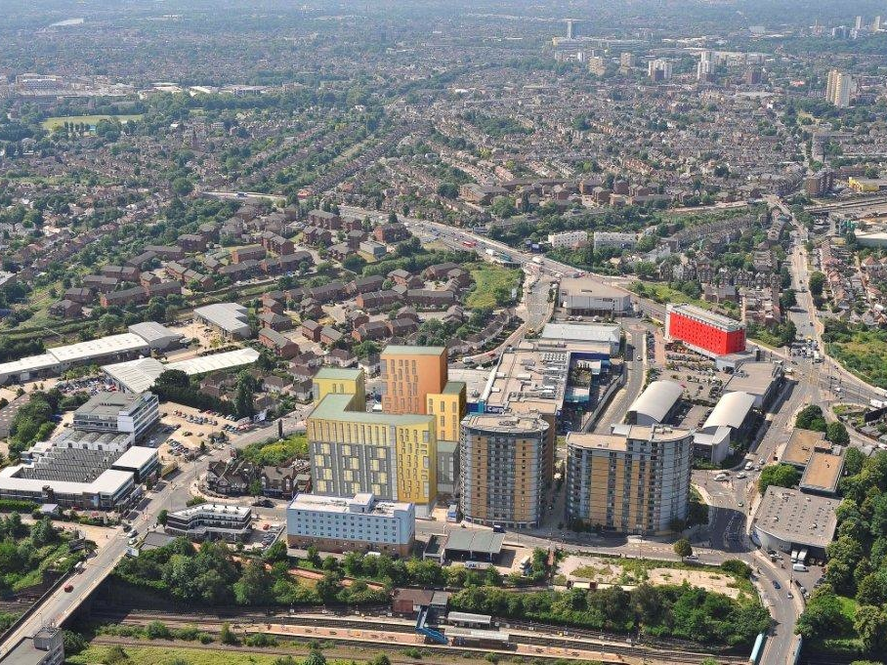
THE AREA
Tretham /Poulton Court
Private residential scheme
257 units completed 2006
The Lyra
Private student accommodation
209 studios completed 2013
The Costume Store
University of the Arts
730 students
Ramada Hotel
One Victoria Road
Imperial College London
693 students
Castle Pub
Station square redevelopment
London Borough of Ealing
In consultation
Tesco’s Cafes and Restaurants
Holiday Inn
Un-named project
151 units Starting 2014
North Acton Underground station

Slide 4
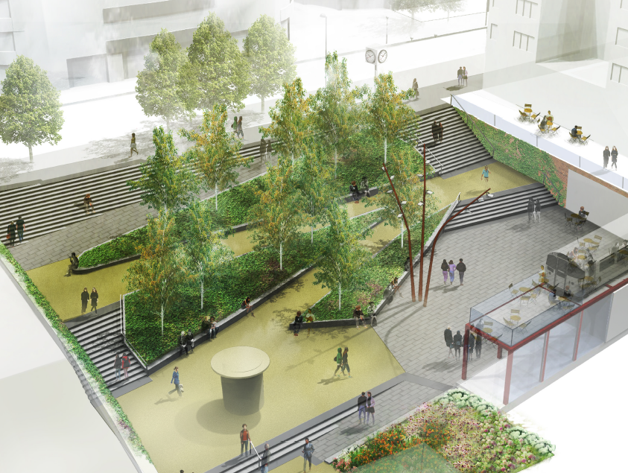
THE AREA

Slide 5

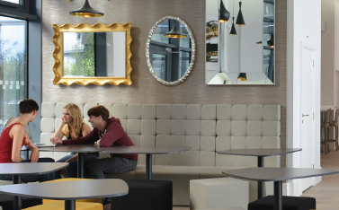
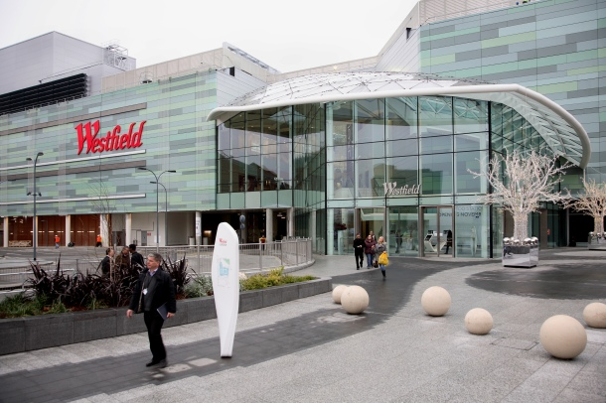
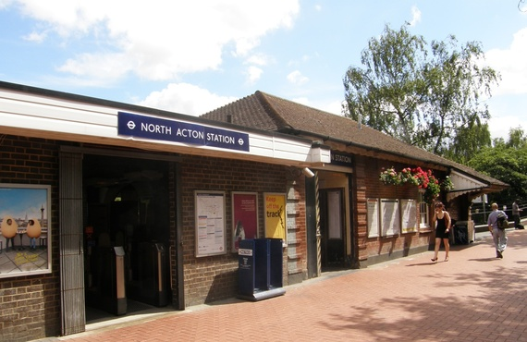
The Area
North Acton has a growing student community:
  The Costume Store – University of the Arts London
  The Lyra – Studio Accommodation
  Two stops on the Central Line from the College’s exciting new Imperial West campus
Local amenities in the area include:
  Tesco – 2 min walk
  Asda Superstore – 10-15min walk
  NatWest Bank – 2 min walk
  Westfield Shopping Centre – 7-8 min tube journey
The area has excellent transport links:
  Located 200m from North Acton tube (Central Line,
  Zone 2)
  Will benefit from future development of Crossrail with Acton mainline becoming one of the new high speed stations in 2018
  Five major London bus routes just a short walk away

Slide 6
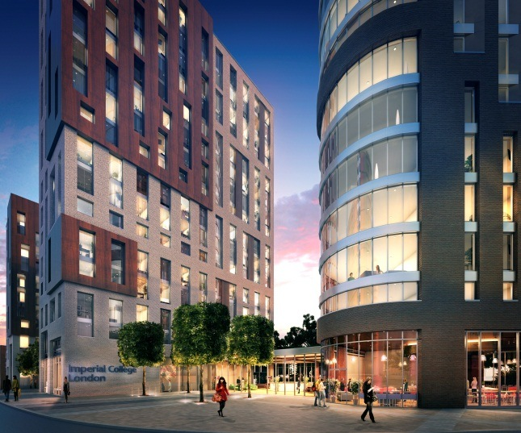
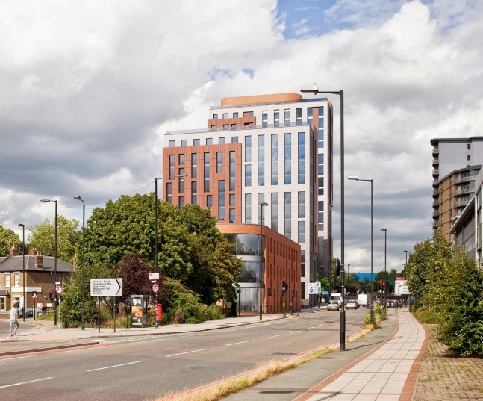
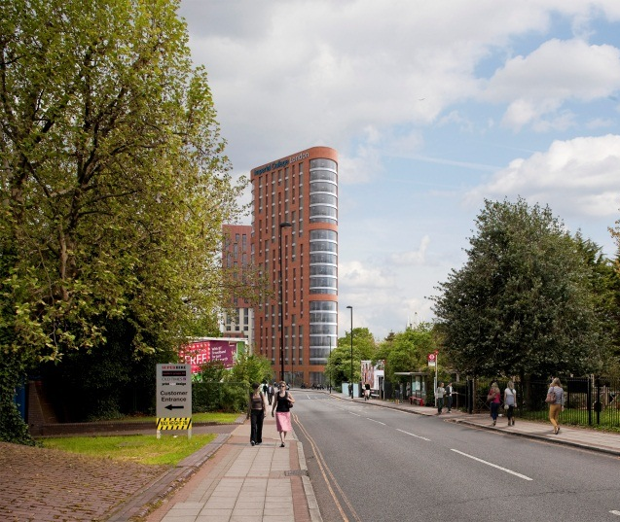
Planning
Scheme has been granted planning for a student accommodation building with 659 bedrooms ensuite bedrooms for 693 students and 14 wardening staff
Mixture of cluster bedrooms (12 ½ sqm), twin rooms (25 sqm) and accessible rooms
5-8 bedroom clusters with their own kitchen/living room space
Will include student support facilities – laundry, 24/7 reception, cycle storage, etc.
Commercial and retail space including bar/restaurant and coffee shop

Slide 7
Programme
Planning consent granted December 2012
Demolition completed May 2013
Student Design Workshop May 2013
Ground works commenced June 2013
Basement complete December 2013
Fit-out commenced March 2014
Sabbaticals Tour April 2014
Topping out ceremony June 2014
Student design consultation June 2014
Freeze final design End-June 2014
First unit complete August 2014
Internal fit-out complete July 2015
Landscaping August 2015
Handover August 2015
Ready for academic year 2015/16

Slide 8
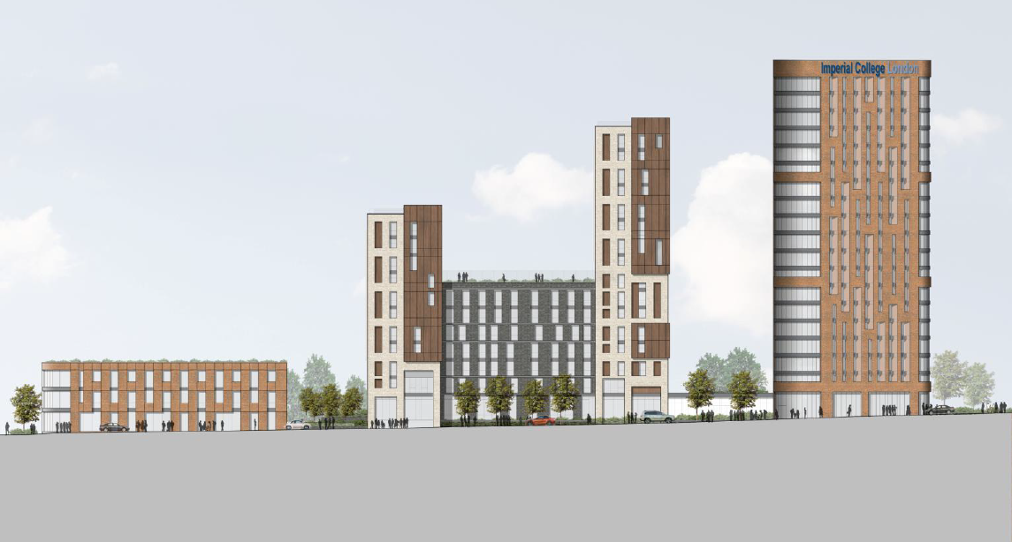
Our New Village
Commercial and community space – planning requirement
Bedrooms and kitchen/diners
Communal spaces to enhance residential experience

Slide 9
Site layout – May 2013, pre-student design workshop

Slide 10
1. COMMERCIAL AND COMMUNITY
REQUIREMENTS OF PLANNING

Slide 11
Commercial and Community Space Approved in Planning
As part of the approved planning application, some space at One Victoria Road is allocated for contributing to the local area. This should provide opportunities for employment to ‘give back’ to the local community
Restaurant and Bar, Volunteer Unit and Pocket Park
Public restaurant and bar with own kitchen
Adjoining volunteer unit which can expand into restaurant/bar – open to the public
Public pocket park adjacent to the restaurant/bar
Coffee Shop
150sqm coffee shop open to the public
Students can use this space out of hours, particularly during exam periods if required

Slide 12
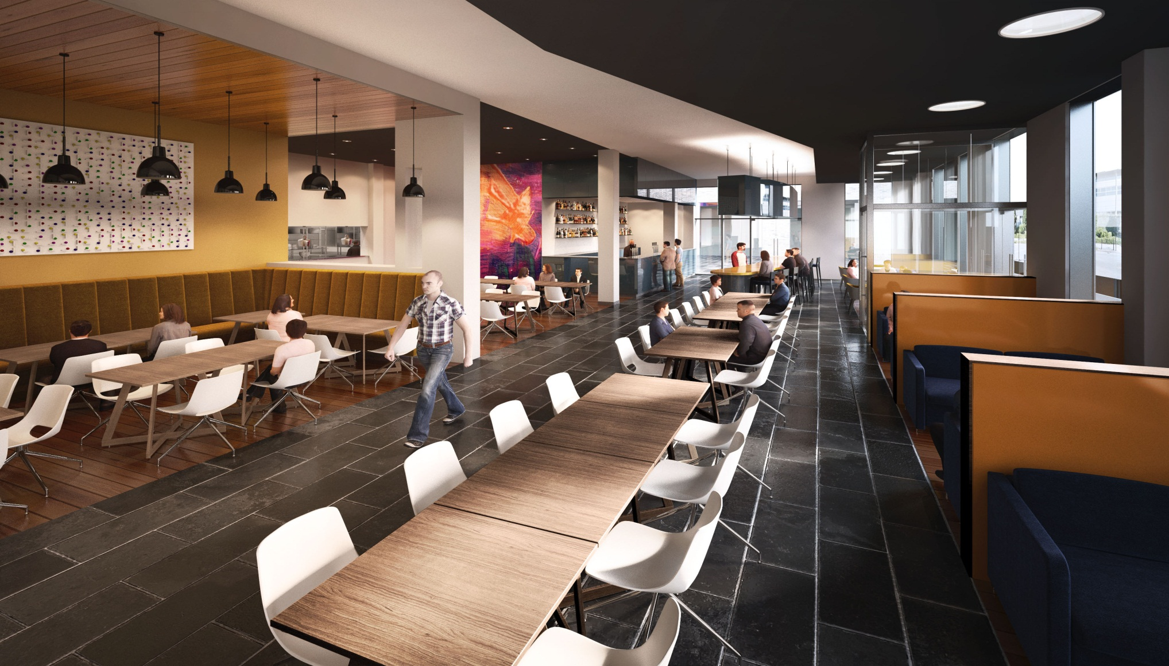
The Restaurant /Bar

Slide 13
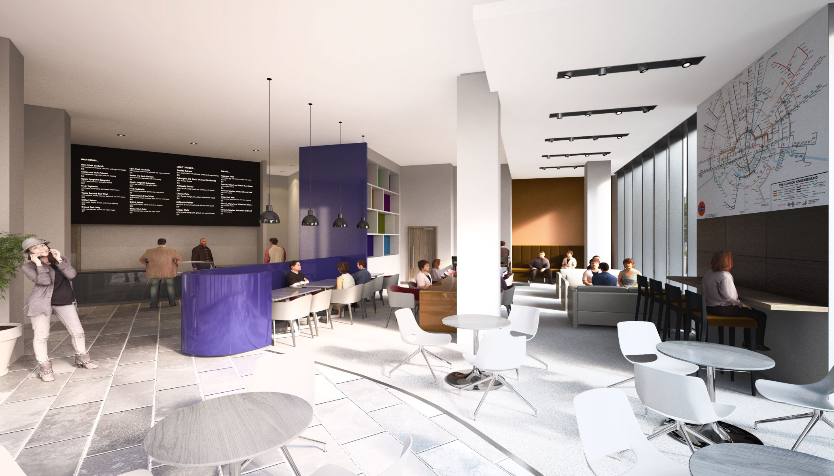
The Coffee Shop

Slide 14
2. Bedrooms and kitchen/ diners

Slide 15
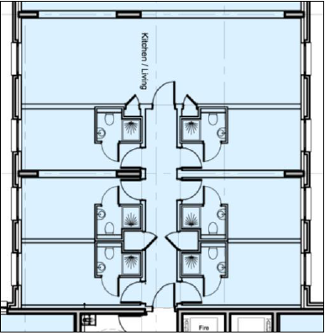
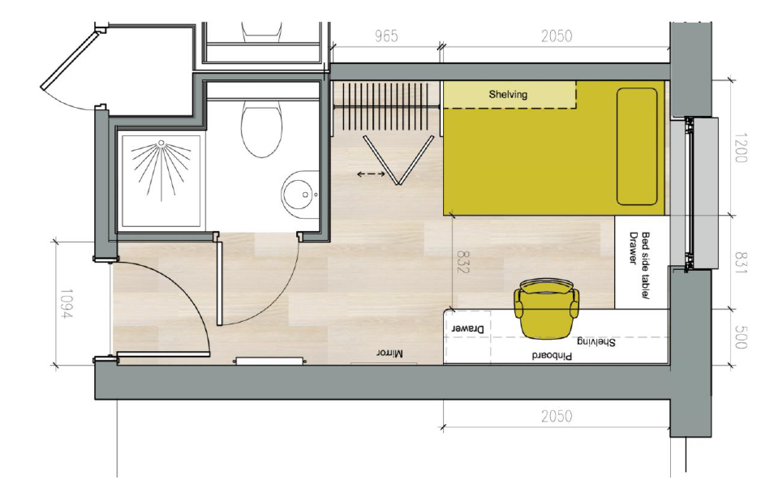
Cluster accommodation layout

Slide 16

Feedback from May 2013
Students felt that the space and layout of the ensuite bedrooms and kitchen-diners arranged in cluster flats was very good (with bedrooms to include small double beds, not single beds)
The original scheme was designed for the cluster flat entrance doors to be locked.
  Students asked for doors to be left unlocked and on hold-back (like Southside and Eastside) allowing students to move freely around blocks and thereby encouraging wider student interaction.
The original scheme allowed for an intercom handset in each bedroom linked to the Reception.
  Students asked if a College telephony system could be installed in all rooms, allowing residents to call each other and all College extensions on campus and in other halls free of charge, while still allowing Reception to use as an intercom.

Slide 17
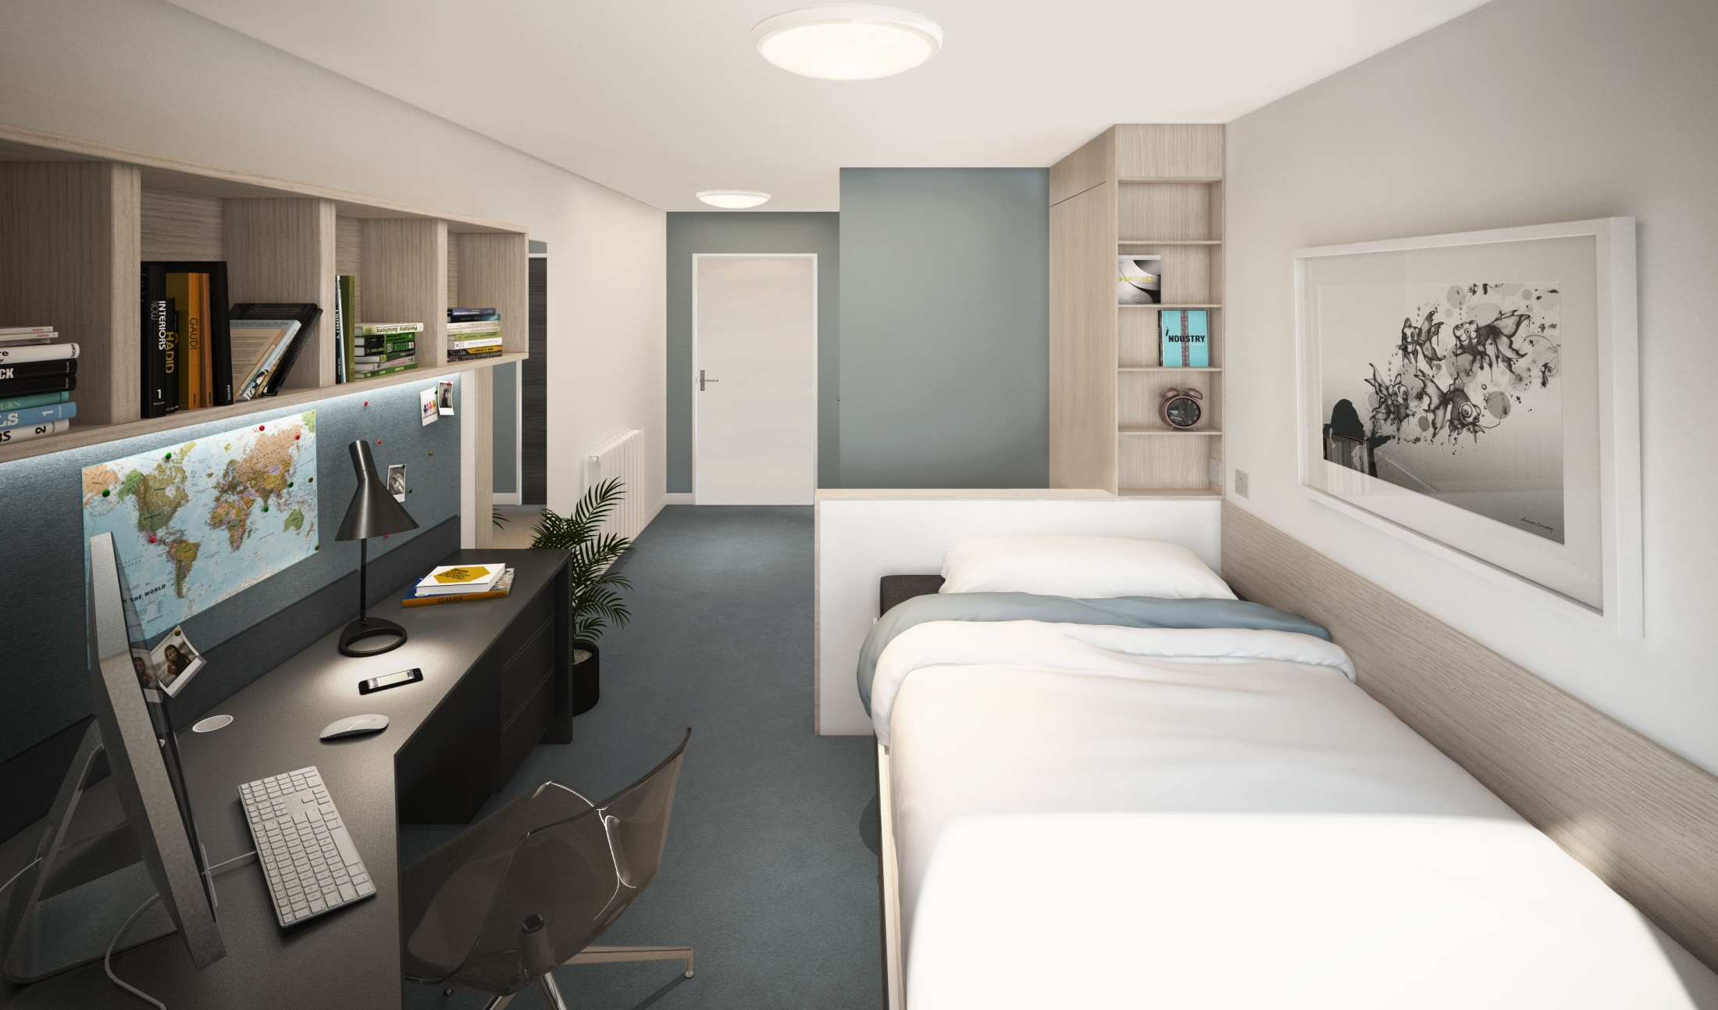
Ensuite bedroom

Slide 18
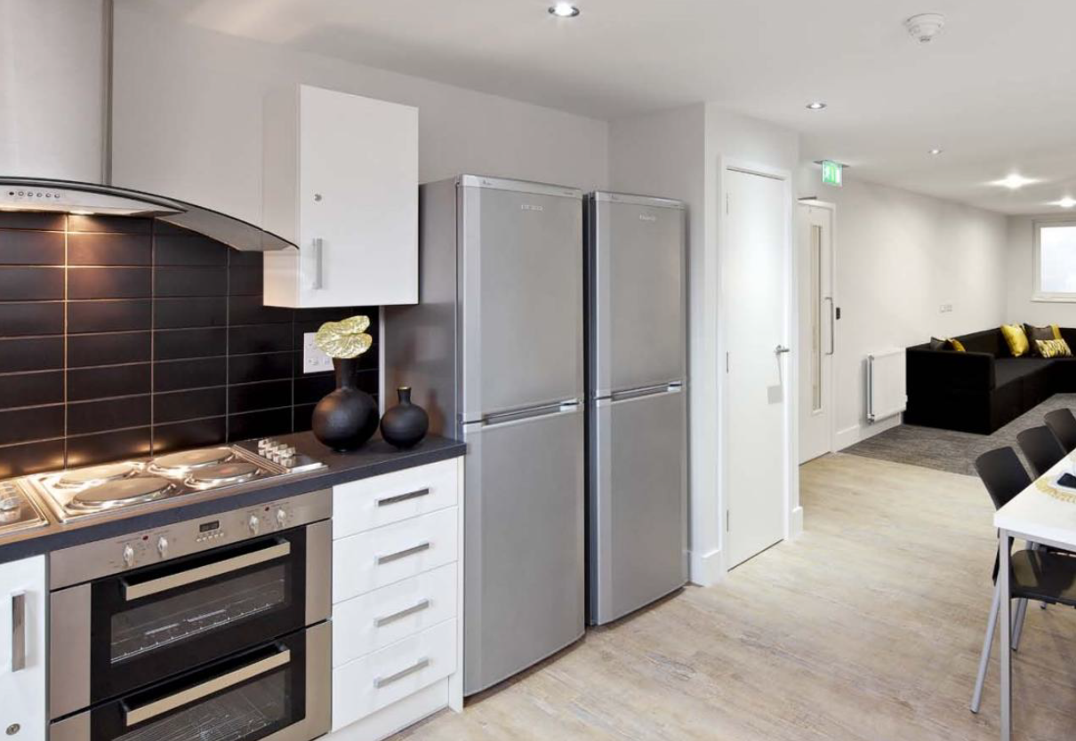
Kitchen/Diner

Slide 19
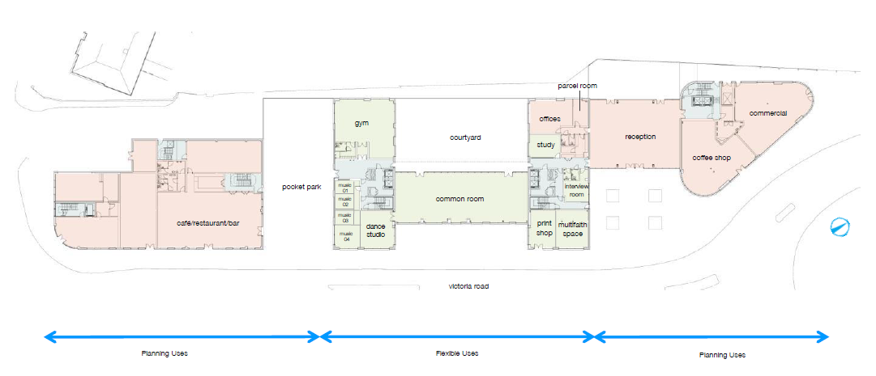
Layout post-May 2013 student design workshop

Slide 20
3. Communal Spaces to Enhance the residential experience

Slide 21
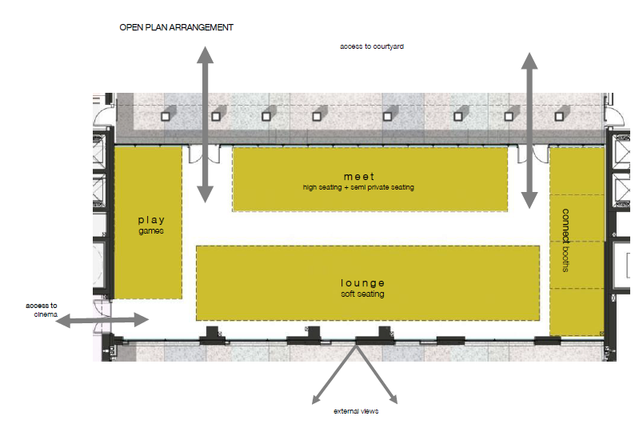

The common room (259 sqm)
Students requested:
An open plan space for flexible use
Clever partitions to be incorporated
TV or large screens
A gaming area
Pool table
Still to be determined:
Seating and use of zones

Slide 22
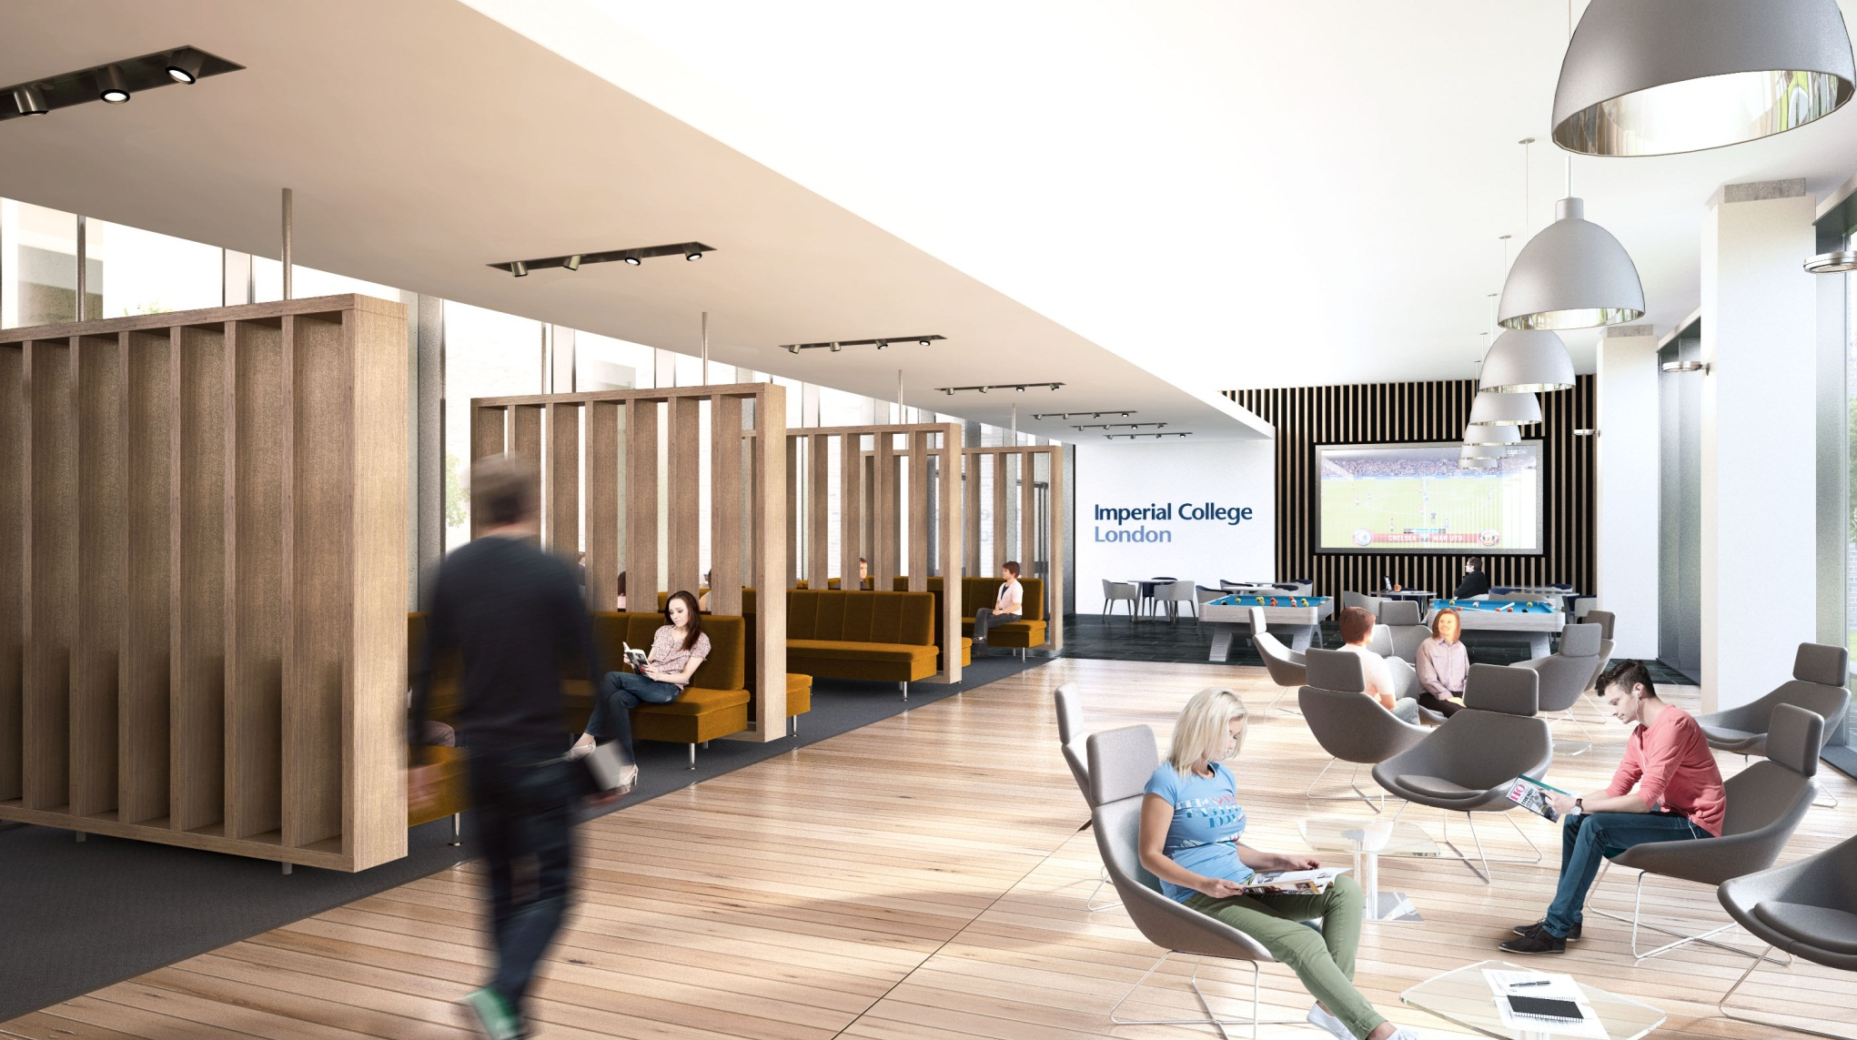
The common room

Slide 23
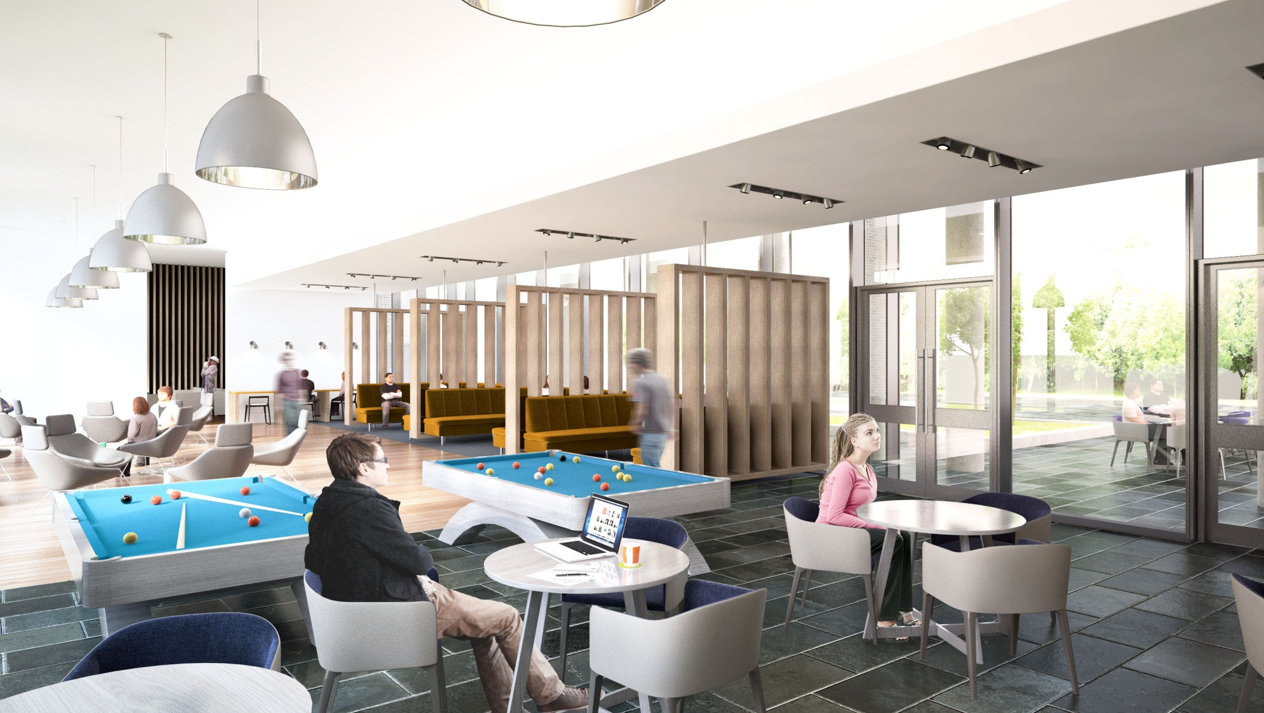
The common room

Slide 24
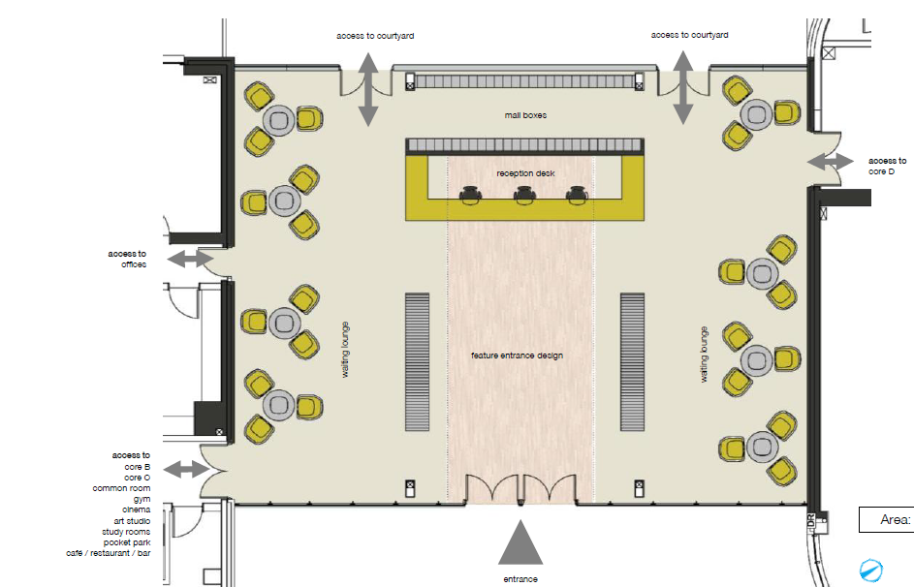
The reception area (250 sqm)
The students suggested this space should:
Be contemporary with a
splash of colour
Have a homely feel, not like
a high-end hotel
Have an Imperial feel
Have welcoming and comfortable seating
Incorporate vending
machines
Still to be determined:
Seating and flooring and use
of space

Slide 25
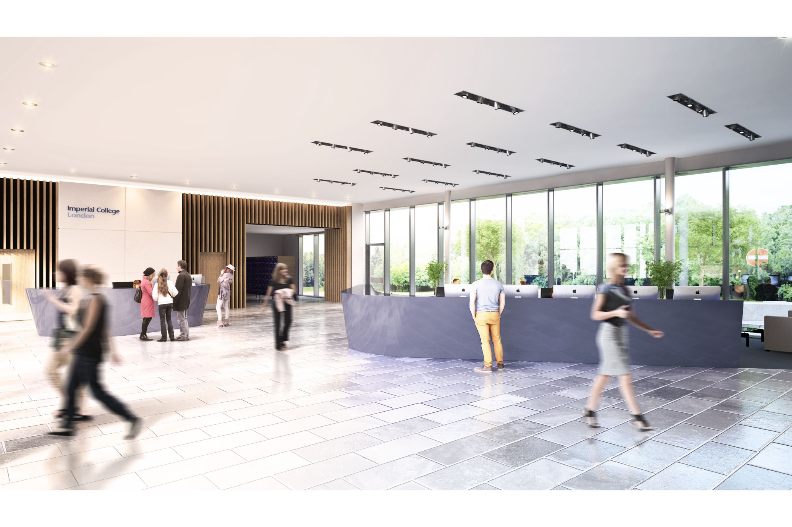
The reception

Slide 26
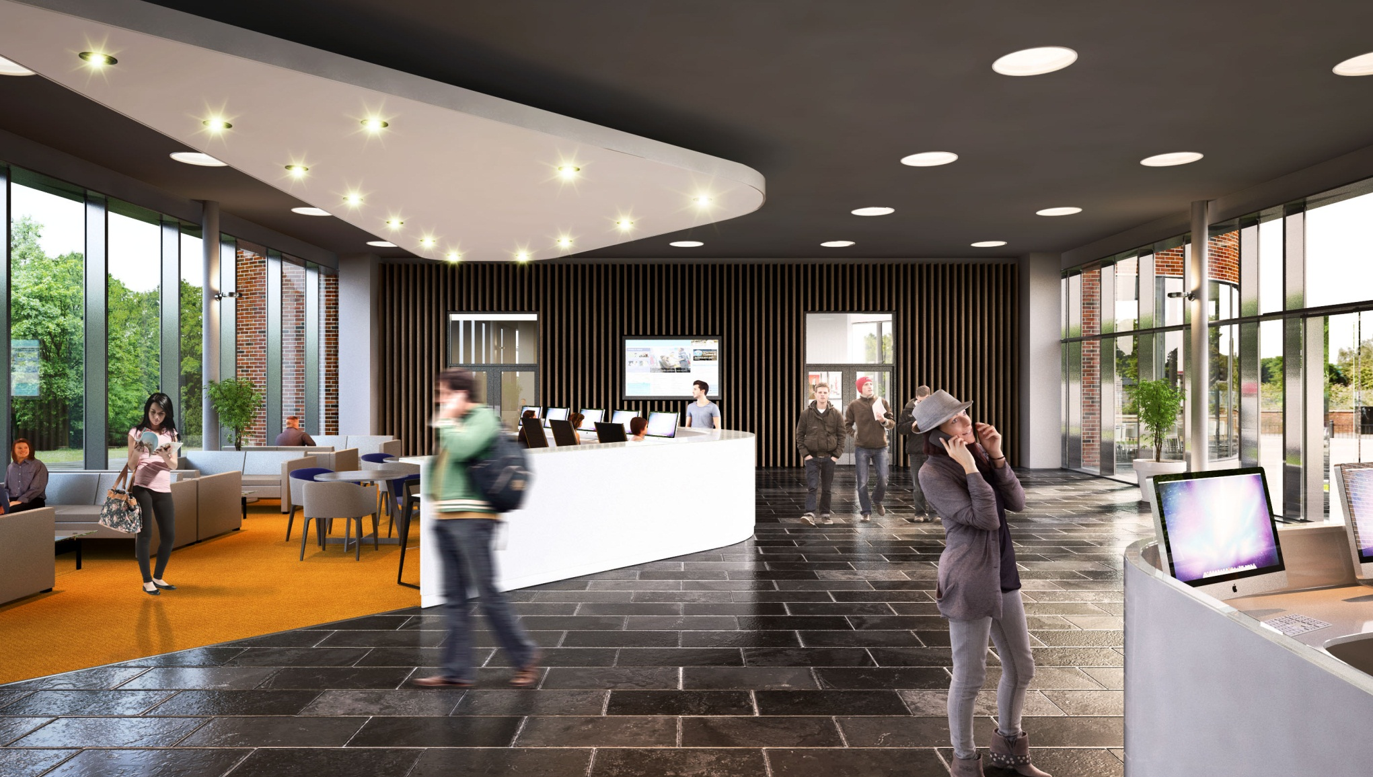
The reception area, introducing student suggestions

Slide 27
Communal and retail space layout – your views?

Slide 28
Other communal areas
Cinema
Students asked for the cinema to be removed and the area to be replaced with…
Multi-Faith/Prayer Room
Dance studio (too small?)
Art Studio/Music rooms
Students asked for the art studio to be removed and replaced with music rooms. Use of nearby Costume Store arts facilities are being explored.
Study Room
Students wanted there to be a variety of different spaces for working in, with some space which can’t be ‘booked’, for example, more free study space could be delivered if the gym were to be relocated.

Slide 29
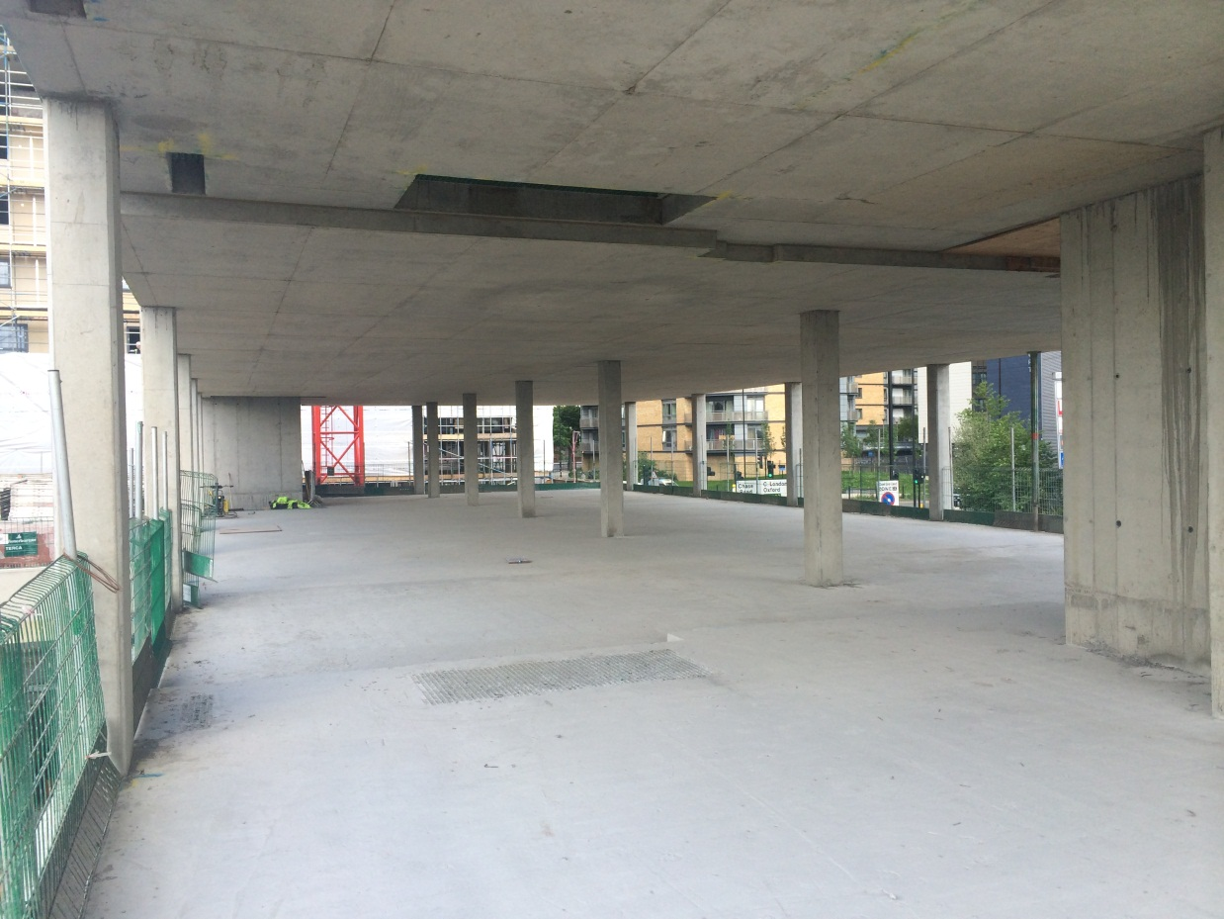
Other communal spaces
Gym
This space was well-received and students felt it would be extremely well used (Ethos too busy at peak times)
Students asked whether occupancy levels could be checked from their rooms
Options for size and location of the gym

Slide 30
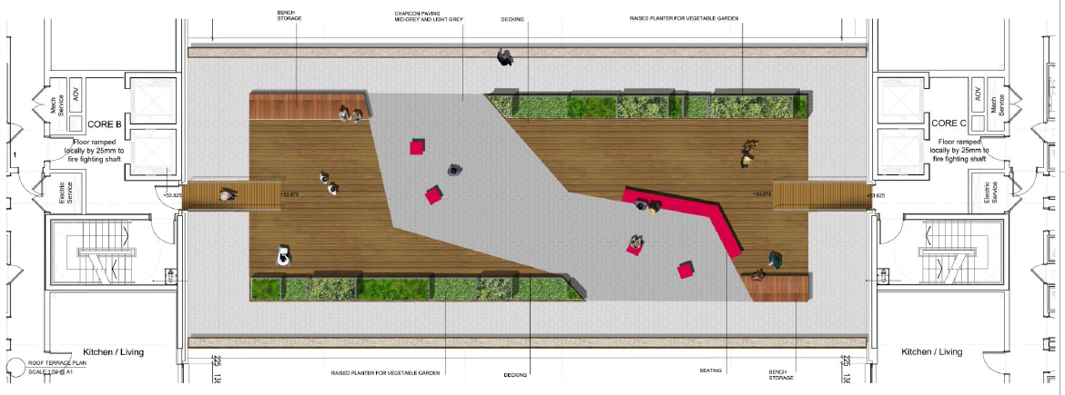
Other communal spaces
Outdoor spaces – roof-top terrace
The students wanted to use the roof-top terrace garden between blocks B and C with secure height parapets
Consider a sustainability project, e.g. herb garden
Installing a BBQ in the rear courtyard area
More tables/benches or more individual reclining seating

Slide 31
Other spaces
Retail unit (169 sqm)
Previous suggestions:
Chemist
Fruit and Veg Shop
Print shop
Hairdressers

Slide 32
Student input required for communal spaces
Space |  |  | Input required
Common room |  |  | Use of zones Seating TV screens
Reception |  |  | How will this space be used? Seating Flooring
Gym |  |  | Location, size and use Hall use only vs. larger public gym
Dance Studio |  |  | Location and size
Study space | Music Rooms | Union/ Innovation hub | Yes, No, Size, Bookable, Non-bookable, How many?
Roof-top terrace |  |  | How will this space be used? Seating
Retail space |  |  | Options?

Slide 33
Next steps
We would very much appreciate your feedback to help shape the communal spaces identified
A short survey will be uploaded on the Union website where you will get the opportunity to have your say!
The survey will be open on Friday, and will close of Wednesday 18 June.
After the survey is closed and comments fed back to the design team, the results of the consultation will be communicated back to you.

Slide 34
questions?

