Slide 1
Academic Representatives
Training 2014/15

Slide 2
“A good representative is, first of all, a good listener” - Mathematics Year One candidate

Slide 3
“I want to make sure I am one of the team who will stand and deliver to ensure the best academic teaching for us all” - Medicine Year One candidate

Slide 4
“I will be dedicated to a 4 point agenda centred around communication links between staff and students: -Give you unparalleled access to decision makers in department. -Reach out to the unheard voices of the department and make your voices heard. -Open the doors necessary to facilitate useful dialogue between members of staff and students. -Work at all costs to make us all (staff and students) feel like winners when decisions are reached.” - EEE Year One candidate

Slide 5
“It will be my aim to increase transparency between the teaching staff and the students, in order to facilitate communication between the two” - EEE Year Three candidate

Slide 6
“I aspire to voice your concerns vehemently at every student-staff meeting and build on the good work done by last year's representatives” - EEE Year Two candidate

Slide 7
“Freshers, your Uni needs you! I will aim to be the voice of the year, getting our needs across to ICSM” - Medicine Year One candidate

Slide 8
Academic Representatives
Training 2014/15

Slide 9
Pascal loose
Deputy President (Education)

Slide 10
Today’s Learning Objectives
Understand what the Academic Representation Network is, and why it exists
Learn the Five Rs of Effective Representation
Understand campaigning and major events each year
Understand how to help students in difficulty
Learn about Imperial Plus and how being an Academic Rep benefits you

Slide 11
DEBRA HUMPHRIS
Vice Provost (Education)

Slide 12
What is the Academic Representation Network?
The Rep Network brings together student volunteers and departmental staff in order to improve teaching, research and supervision at Imperial

Slide 13
What is the Academic Representation Network?
A decentralised, distributed network of trained student volunteers ‘on the ground’ – YOU
Quick, student-led feedback on every lecture slide, every assignment, every handout, every lab
A bottom-up approach to quality, led and shaped by students.

Slide 14
What is the Academic Representation Network?
A department can access a team of Reps specific to its courses and democratically elected by its students.
A vital tool in keeping departments at the cutting edge of teaching and research in their field

Slide 15
How to be an effective rep
Andrew Keenan, Education & Welfare Manager, on

Slide 16
The five rs

Slide 17
STEP ONE: RECEIVE
A Lecture shouts | B Departmental email | C Role & details in email signature

Slide 18
STEP TWO: RESEARCH
A Facebook groups | B Use the Union | C Past SSC papers

Slide 19
STEP THREE: REPRESENT
A Emphasise research | B Prepare with peers | C Speak for all

Slide 20
STEP FOUR: RECORD
A SMART Goal tracker | B Inform Dep Reps and AAOs | C Keep notes and emails

Slide 21
STEP FIVE: REPORT
A Feed back on Facebook | B Termly update email | C Let the Union know

Slide 22
SSCs (Staff – student committees)
At least once a term, often twice | The most important forum for making your views heard | 150+ SSCs across College

Slide 23
Student Consultation Framework imperialcollegeunion.org/consultation
For the really big decisions – new buildings, new labs, new courses | Guidance for College on how to make big decisions with actual student input | Uses the Academic Representation Network as source of student opinion

Slide 24
Making change & KEY EVENTS
Sky Yarlett, Representation & Campaigns Coordinator, on

Slide 25
Your Role In Making Change
You are the link between students and the academic decision making body.
Students will be directly affected the problems, you might even be experiencing these issue.
You will in a position to gather information and lobby for change.
You can do this through surveys to students, presenting problems and solutions to SSC’s.

Slide 26
Examples of changes
Better use of Lecture Recordings
Many students feedback that lecture recording equipment isn’t utilised correctly.
Better resources
Whether its more computers, more focused careers events, or more lab time.
Big changes: challenging the 100% late coursework penalty
If each year rep spoke to just 20 students in each year we’d have thousands of opinions which the union could to persuade and convince.

Slide 27
Communicating is Key!
Speak to your students! Identify problems and solutions
Problems: Identify what is making this happen, is it deeply or widely felt.
Solutions: Identify who can make the solution happen, and what will convince them to make the change
Talk to co-reps – this includes Year Reps and Dep Reps
Not only might they have experience or ideas which make help.
They will be able to support you when making change or presenting information at SSC
Speak to Deputy President (Education)
This might be a recurring issue across college – and by bringing it to DPE’s attention you might be able to spark a wider conversation
Bring it up to academics / at SSC meetings
The problem might not be limited to students, for example lecturers might not have had the training to use the programs.

Slide 28
Rep Week
Aim:
Tell students what Academic Reps are
Gather problems and issues from students
Biannual event
10 – 14 Nov 2014, 9 – 13 Feb 2015
How?
Stalls around College, Feedback slips, Online publicity
Notes:
Total of 717 suggestions received in 2012/13 academic year.

Slide 29
Where do Year Reps fit in?
We need Year Reps to help out:
Minimum commitment of 2 hours (over the course of a week)
Lunchtimes & afternoon
Help out on the stall
Free Rep Week t-shirt
Counts towards Imperial Plus
certificate/accreditation
Notes:
If interested get in touch with me at the end of the session. I’ll also send an e-mail around asking for volunteers.

Slide 30
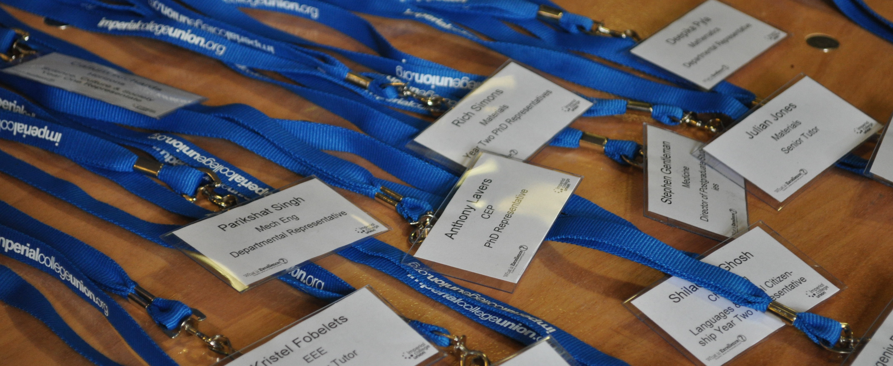
Representation Conference
Notes:
Inaugural Conference
Feb/March 2014. All invited

Slide 31
Representation Conference
Aims:
To celebrate achievements of Reps and share good ideas
To ensure College staff are aware of the Academic Representation Network and use it well
Provisionally scheduled for 11 February 2015
Notes:
Exist at a number of other universities. High profile event.

Slide 32
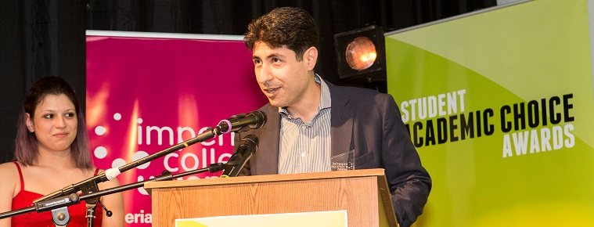
Student Academic Choice Awards
Notes:
Inaugural Conference
Feb/March 2014. All invited

Slide 33
Student Academic Choice Awards
Aims:
To celebrate excellence amongst Imperial College staff in a number of areas.
To create a positive conversation about good things – Reps are not just about identifying the bad things!
Nominations open on Monday 10 November and close Friday 13 February – who will you nominate?
Notes:
Student panels (made up of Reps & Sabbs) decide who wins.
Ceremony being held in Easter term. Large scale event. Opportunity to socialise & mingle with staff.

Slide 34
What do Year Reps have to do with the SACAs?
We need you to:
encourage students to nominate College staff
promote event to staff within your department
Why?
Encourages College staff to focus on areas often ignored like feedback/teaching/supervision etc.
Increases awareness of Academic Reps and the improvements students want to see.
Shows students that their needs are being promoted
Notes:
Academics encouraged to prioritise research – tends to be main area of acknowledgement.
All academics involved (nominated, shortlisted & winners) are reminded that students prioritise things other than research.

Slide 35
PASTORAL CARE & confidentiality
Christopher Kaye,
Deputy President (Welfare), on

Slide 36
Key points
Academic Reps do not offer pastoral care or advice
You can point people to professional support and make them aware of basic rights
You will probably be approached by students in difficulty. If this happens, we are here to help you – as are many other sources of support.

Slide 37
“I think I might be dyslexic… what do I do?”
Notes:
The correct answer is the Disability Advisory Service, who can advise students on any kind of disability – mental, physical, learning – including permanent and temporary disability.
There are also Departmental Disability Officers – one for each department – who can also help with support within departments, such as special exam arrangements

Slide 38
“The workload is too much and I’m finding it hard to cope”
Notes:
This is something you might hear often – it can be a relatively common complaint for Imperial students to make. The first person to send a student to is their personal tutor. If their personal tutor doesn’t answer, send them to your department’s Senior Tutor.
Sometimes, a student saying this can be an indicator of something more serious. The Student Counselling Service can help students who are having emotional problems, which can often affect their studies.

Slide 39
“English isn’t my first language and I find it hard to write in the correct academic style”
Notes:
Imperial has students from all over the world, meaning our students come from a wide range of school systems – all of which have different accepted styles for academic writing. Any student can find it hard to write in the appropriate scientific tone, and if international students are also struggling with knowing technical terms in English, their work can suffer more than most.
The Centre for Academic English, formerly known as the English Language Support Unit, can help any student with their English skills – for academic purposes, and also for socialising and being part of the Imperial community.

Slide 40
“I want to appeal against my exam marks”
Notes:
If a student is unhappy with an academic decision – such as an exam grade, or the termination of their studies – they can appeal. They can receive professional, independent help on this from Imperial College Union, who employ a full-time Student Adviser to help students remain at Imperial.

Slide 41
Confidentiality
A situation in which information must be kept secret and private
Occasionally you may be entrusted with another’s confidence
You MUST break confidentiality when someone could do harm to themselves or others in the College community.

Slide 42
Imperial plus
Nick Snow, Student Development Manager, on

Slide 43
Key things to remember
Very little extra effort required
You’re creating a record of your achievements and skills
Union staff and trainers are here to support you

Slide 44
Why Register?
Get the recognition you deserve!
It’s flexible:
Imperial Plus Volunteer Certificate
Imperial Plus Volunteer Accreditation
Imperial Plus Volunteer Qualification
Log hours from multiple roles volunteered in one academic year
Notes:
***the Volunteer Certificate and Volunteer Accreditation must be completed within one academic year, from 1st August – 31st July

Slide 45
Imperial Plus
Launched in 2013, Imperial Plus aims to:
Help volunteers clearly identify the skills they gain through involvement in our activities
Encourage volunteers to recognise the value of these skills and how they enhance their employability
Be relevant and accessible to all volunteers
Enable the Union to formally acknowledged the contribution volunteers make towards delivering our services

Slide 46
Imperial Plus: key skills
Communication
Team Work
Planning and Organising
Persuasion and Negotiation
Problem Solving
Personal Effectiveness
If you can develop these skills – and build up the evidence to show you have them – it’ll put you in a strong position for the future to pursue a career in whatever field you eventually select’
(NUS, Working Towards Your Future 2011)
Notes:
Imperial Plus is based around six key skills.
Communication
Team Work
Planning and Organising
Persuasion and Negotiation
Problem Solving
Personal Effectiveness
These skills were also those included in a recent report by the NUS and Confederation of British Industry as some of the key skills that employers look for in Graduates.

Slide 47
Imperial Plus Volunteer Certificate
No additional effort required! Once registered:
Initial skills self-assessment ranking 1-10
Complete all mandatory training
Log 25, 50, 75 hours
Short skills questionnaire
Final skills self-assessment

Slide 48
Imperial Plus Volunteer Accreditation
More commitment, externally accredited by ASDAN:
Self assessments 1-10
Complete all mandatory training
Log 100 hours
Participate in 4 Introduction to… skill based workshops
Produce a short assignment reflecting how learning outcomes have been implemented in volunteer role

Slide 49
Rep Volunteer Hours
Academic Rep meetings (including preparation time):
Year/Department meetings
Staff-student committee meetings
Meetings with DPE/Union staff
Meetings with students
Rep Training, Rep Week, Rep Conference, SACA Panels
Gathering views and opinions from students and providing them with feedback on any decisions and outcomes
Any other volunteering roles you hold with or via the Union/College

Slide 50
Imperial Plus Volunteer Qualification
Applications open at Easter
ILM Level 5 Management of Volunteers
Promote volunteering to potential and actual volunteers
Manage the Motivation of Volunteers
Develop Working Relationships with Colleagues and Stakeholders
Provide leadership and direction for own area of responsibility
Hugely beneficial to volunteers responsible for supervising other volunteers & future leadership roles
Majority of places reserved for those achieving Accreditation
Must have a Volunteer position lined up for 2015-16 with/via the Union where the Qualification will be utilised
Notes:
For those that have achieved the Volunteer Accreditation… they will be invited to apply to work towards the Imperial Plus Volunteer Qualification from the start of the summer term.

Slide 51
Imperial Plus: Year One
In quotes:
“It does not take much additional work, but offers students the recognition of their work”
“I didn’t realise how many hours I actually put in before!”
“The feeling you have when you know that in the past hour you have actually gained very useful skills.”
“The recognition, especially the Volunteer Qualification programme which I am on. It is an invaluable opportunity to up skill myself”

Slide 52
Imperial Plus Registration
To register:
Visit imperialcollegeunion.org/imperialplus
Volunteer Accreditation Workshops:
Visit imperialcollegeunion.org/whatson
Questions, advice, help:
Email imperialplus@imperial.ac.uk

Slide 53
Community Connections
The Union’s volunteer service connecting Imperial Students to their local community through Volunteering
Students can top up their Imperial Plus volunteering hours
Find regular or one off volunteering opportunities with 60+ charities and community organisations
Take part in fun and rewarding Mass Volunteering opportunities where you instantly see the difference you make

Slide 54
Questions?
imperialplus@imperial.ac.uk
volunteering@imperial.ac.uk

Slide 55
RSA Video
https://www.youtube.com/watch?v=KDhhIghXxfo&index=7&list=PLMo9vqiZPs0RQa_kypIS3tchANZa-MJGO

Slide 56
Any questions for us?

Slide 57
Please fill an evaluation form and leave it with one of the speakers

Slide 58
Thanks for coming, and have a great year!

